Slide 1
HTTP Overview & REST Web Services

Slide 2

HTTP Overview

Slide 3
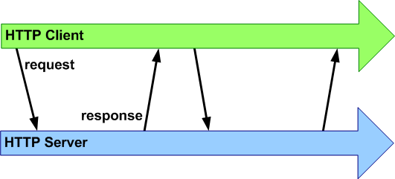
Clients & Servers
Clients: initiate HTTP requests to web servers
Servers: send HTTP responses to client requests. Responses are composed of headers and a body

Slide 4



HTTP Protocol
Protocol used for making requests to web servers
Protocol used by web servers for sending documents, page assets, & resources to clients
HTML files
JavaScripts
CSS files
Images
XML / JSON

Slide 5
HTTP Verbs
When you visit pages on the web either by clicking different hyperlinks or by typing an address into the URL bar, you are making GET requests.
Forms allow you to make both GET and POST requests. With a POST request, your data is sent as part of the HTTP request body.
PUT & DELETE
* You can view request & response headers and bodies by clicking on the Network tab in Chrome's web inspector

Slide 6
RESTful Web Services

Slide 7
Web Services / Web API’s (Application Programming Interface)
API’s serve as a way to interface or communicate with other software or services
Google Maps API provides objects/classes for you to access Google Maps from your application in JavaScript
ITP site – Twitter
Web Services allow developers to build web pages/apps using data from multiple online sources, referred to as “mashups”
Example: housingmaps.com

Slide 8
RESTful Web Services
REST is a simple approach to web services using HTTP
3 parts:
URL/endpoint of the web service
HTTP operations/verbs supported by the web service
GET, POST, PUT, DELETE
Returned data (if any) response formats (typically XML & JSON)
Notes:
http://api.cats.com/cats/kittens?color=black

Slide 9
HTTP Verbs / Operations
GET: Used to fetch a single or collection of resources
POST: Used to create a resource
PUT: Used to update a resource
DELETE: Used to delete a resource
All request types can be made using an HTTP request library like cURL

Slide 10
Basic Process in 3 Steps
Determine the URL/endpoint for the web service (via API documentation)
Pass parameters through the query string
Make an HTTP (GET, POST, PUT, DELETE) request for your operation
If the service returns a response (typically XML or JSON), parse the contents of the response

Slide 11
Other Types of Web Services
SOAP = Simple Object Access Protocol, also popular but typically more complex and ‘bulky’
XML RPC = Remote Procedure Call

